Slide 2
" In The Name of Allah, The Most Beneficent, The Most Merciful" The real Halal 5F-Halal By: Dr. Hani M. Al-Mazeedi

Slide 3
Opening message is that ingredient technology has become a complex complicated field beyond the perception of an average Consumer
Dr. Muhammad Munir Chaudry
President, Islamic Food & Nutrition Council of America (IFANCA)
Dr. Hani Mansour Al-Mazeedi
Researcher, Kuwait Institute for Scientific Research - State of Kuwait

Slide 4
Scope
This presentation shed the light on the 5F-Halal model as the mostly demanded Halal requirements by Muslim consumers that when followed it will provide 100% pure Halal services, Halal process, and Halal products.

Slide 5
The main objective of this presentation is to introduce 5F-Halal requirements as the basis for all of Egypt Halal activities that require the label Halal.

Slide 6
Outline
Introduction to the 5F-Halal model
Conclusions
Recommendations

Slide 7
Halal processes, production, services and products are currently facing many emerging issues نوازل that were not known at the time of early Muslim scholars.
Muslim scholars are urged to review current processing techniques being followed in the west to avoid the fall of Non-Halal products, production, & services in the hand of Muslim consumer.

Slide 8
Negative aspects of international HALAL standards
All Halal standards are similar in their general requirements in promoting Halal and avoiding Haram. However, they are too loose if read carefully especially the requirements that touch certain economical issues that mainly serve the interest of the western industries more than Allah’s demands that ultimately serve the interest of Muslim consumer such as:

Slide 9
Stunning of animal before or after slaughter (allowed if necessary)
Allowing the presence or the use of Najis (religiously prohibited ingredients) due to controversial religious edicts (Fatwas فتاوى) based on the concept of transformation (Istihala).
Allowing the use of Alcohol (synthetic) for manufacturing certain ingredients (How can one be sure it is synthetic as chemically they are all the same ; Ethanol, cause drunkenness, and toxic).
Allowing the trade of product that resemble Haram products , e.g., alcohol-free beer and lately alcohol-free Whiskey drinks.

Slide 10
Advantages of the 5F-Halal model
The 5F-Halal model provides guidelines that will ensure 100% pure Halal processes, production, services, logistics, and products of food and drinks, leather garments medicine, cosmetics, skincare and healthcare products.

Slide 11
5F-Halal stand for
Free from stunning
Free from mechanical slaughtering
Free from Alcohol
Free from non-Muslim slaughter men
Free from Haram Najis ingredients or Istihala*
*As a mean of looking at Haram Najis ingredients as Halal based on the assumption of transformation or consumption.

Slide 12
The value of having 5F-Halal model is to ensure purity of Halal in processes, production, services and products at a time where doubts in Halal are prevailed.
The 5F-Halal model we are about to present is basically rely on giving priorities to the followings:

Slide 13
Identify and control Halal Critical Points for the whole Halal chains
Employ only trustworthy Muslims in sensitive points for the whole Halal chains especially R&D Halal activities.
Putting emphasis on safety and hygienic practices is a priority.
Any substances causes harm to human being is considered as Haram.

Slide 14
No product that resemble Haram products will be accepted even if it contain Halal ingredients.
Any Halal products that is consumed through the mouth, or used on the skin, or used in brushing the tooth must be 100% free from Haram ingredients.

Slide 15
Halal ingredients must be obtained from trustworthy Halal certification bodies (5F-Halal certified).
Khamerخمر (wine), alcoholic drinks, their by-products, and industrial ethanol or biologically produced ethanol are all Haram.

Slide 16
All products that contain ethanol alcohol (intoxicating substance), or produced through the use of ethanol alcohol are Haram.
Alcohols must not be used in processes, production, services and products or in processing plants in any sanitation procedures.

Slide 17
Cases were alcohol is used in cleaning a second cleaning round is required using non alcoholic cleaning agent.
Blood and its by products materialistically are Haram and can not be used in culture as well.

Slide 18
Any food additives produced from Najis animals, or from Halal animal that are not slaughtered according to Islamic rites are Haram.
Genetically modified plants from Haram sources are Haram.

Slide 19
Molds and bacteria used in Halal products must be produced in nutritious media free from Haram materials and should not harm health.
Packed Halal products must be stored in a separate identified area.

Slide 20
Necessary steps must be taken to avoid mixing packed Halal ingredients or products with non-Halal packed ingredients or products or Haram or Najis materials.
Packaging materials should not contain any Haram or Najis materials

Slide 21
Special identification labels must be used on Halal ingredients or products or their storages areas.
Feed must be free from Haram or Najis ingredients.
No Haram tools or non-Halal technologies are allowed in R&D or in the production of Halal products.

Slide 22
Dressing operations on animal or bird in slaughterhouses should start only after their complete death.
Production or R&D activities environment and internal manufacturing procedures of Halal products must be assessed and verified frequently.

Slide 23
Religious and scientific committees are required in a 5F-Halal model.
Never ever give a religious rule on Najis material as becoming Halal based on assumed Istihala.
If the above conditions were applied only then Halal certifications are issued.

Slide 24
Most international Halal standards have religious violations
Therefore one must review some of their violated items
5F-Halal model has no religious violation
5F-Halal model is a strict Halal standard to be

Slide 25
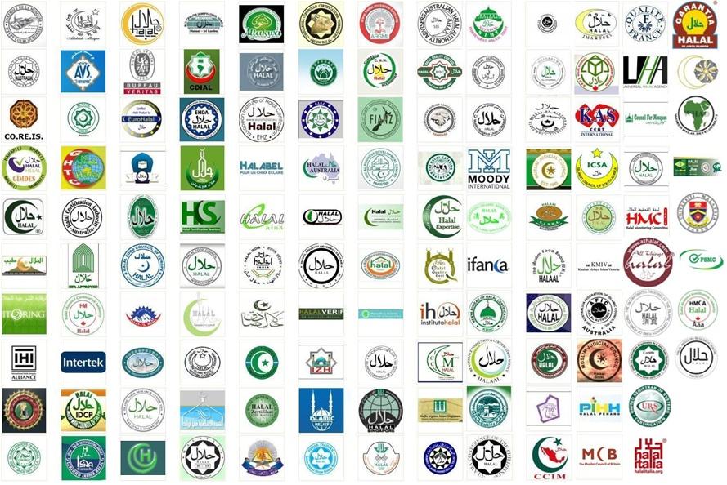
It must be emphasized that the Halal slogan
is not just a logo
but it is a Shahada
that one will be accounted on the day of judgment.

Slide 26
Conclusions
The real Halal model must be based on strict religious Islamic verdicts to ensure Halal validity.
2. Innovations must be introduced to the Halal industry in order to fulfill Halal requirements.
3. Training of Halal stakeholders and their employees is a key factor in Halal assurance.

Slide 27
4. Importation of Halal products can be guaranteed to be pure 100% Halal if imported from Muslim countries strict on Halal (e.g. 5F-Halal).

Slide 28
Recommendations
Muslim Countries should be firm on the application of their Halal regulations on imported products from non-Muslim countries.
2. Routine visits to Halal products plants and R&D centers in non-Muslim countries is of great important to ensure outsourcing of new innovations and implementation of strict Halal regulations.

Slide 29
3. Establishment of Halal Authority that will institutionalize Halal and centralize its Halal control is a solution to Halal constrains.

Slide 30
Finally
Muslim consumers have the right to be ensured that what they pay for and what they eat is 100% pure Halal, this task is the responsibility of the regulators in importing countries.

Slide 31
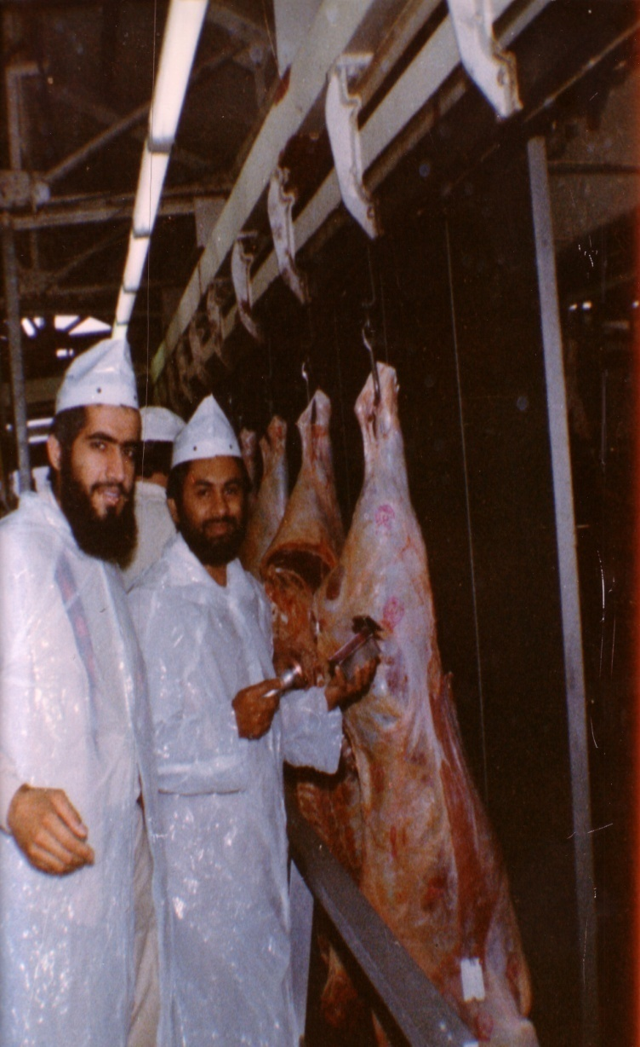
سبحنك اللهم وبحمدك أشهد أن لا إله إلا أنت، أستغفرك وأتوب إليك
mazeedi@hotmail.com
Mobile 0096597498500
Dr. Hani Mansour Al- Mazeedi
With brother Amjad Mahboob in Australia in 1981

Slide 32
References
15- استشاريون:
المملكة العربية السعودية: د. زهير ملا، الهيئة العامة للغذاء والدواء السعودية SFDA
المملكة العربية السعودية: د. عبد القاهر قمر، مجمع الفقه الإسلامي الدولي IIFA
دولة الإمارات العربية المتحدة: خالد محمد شريف محمد العوضي، بلدية دبي، رقابة الأغذية
تركيا: د. حسين كامي بايوكوزر، GIMDES
ماليزيا: ذو الكفل مات هاشم، جامعة بوترا
ماليزيا: دارهيم دالي هاشم، تكامل الحلال الدولي IHIA
ماليزيا: أ.م. شريف الدين محمد شعراني، جامعة صباح الماليزية
ألمانيا: محمود ططري، رقابة الحلال
فرنسا: حنان رزوقي بيزيت، أسيدكوم لحماية المستهلك المسلم ASIDCOM
الولايات المتحدة الأمريكية: د. محمد منير شودري، المجلس الإسلامي الأمريكي للغذاء والتغذية IFANCA
نيوزيلندا: د. أنور غني، اتحاد الجمعيات الإسلامية النيوزيلندية FIANZ
جنوب أفريقيا: مولانا نافلاخي، هيئة الحلال الوطنية لجنوب إفريقيا SANHA
فلسطين: عائدة قادر غانم، جامعة القدس
الكويت: د. أحمد الحجي الكردي، وزارة الأوقاف والشؤون الإسلامية
الكويت: د. هاني منصور المزيدي، معهد الكويت للأبحاث العلمية، KISR
16- راجعه ودققه:
أ.د. حسام الدين عفانة، أستاذ الفقه والأصول / جامعة القدس /فلسطين المحتلة.
د. أيمن محمد العمر، باحث شرعي في إدارة الإفتاء، وزارة الأوقاف والشؤون الإسلامية-الكويت
13- فريق صياغة الدليل:
أ. م. مريم عبد اللطيف، جامعة صباح الماليزية، ماليزيا.
د. شحيمي مصطفى، نائب المدير، جامعة بوترا، ماليزيا.
د. محمد أحمد القريشي، أستاذ جامعي، دائرة الشؤون الإسلامية، دبي، الإمارات العربية المتحدة.
د. عبد القاهر قمر، مجمع الفقه الإسلامي الدولي IIFA.
مفتي محمد زبير بت، لجنة متابعة الحلال، المملكة المتحدة.
الشيخ د. أمير زيدان، النمسا.
مولانا سعيد نفلاخي، هيئة الحلال الوطنية لجنوب إفريقيا SANHA.
أ. عائدة قادر غانم، باحثة في الفقه والتشريع وأصوله، جامعة القدس.
حنان رزقي بيزيت، أسيدكوم لحماية المستهلك المسلم ASIDCOM.
محمد بن خليفة، فرنسا.
عبد الرحمن بوزيد، فرنسا.
14- المراجع:
معيار الحلال "اتحاد المنظمات الإسلامية في نيوزيلندة" FIANZ
معيار الحلال "الاتحاد الاسترالي للمجالس الإسلامية" AFIC
معيار الهيئة السعودية للمواصفات والمقاييس والجودة 2172/2003
معيار هيئة التقييس لدول مجلس التعاون الخليجي 993/1998
المعيار الماليزي إم إس 1500:2009
المعيار CAC/GL 24-1997
نظام ضمان الحلال الإندونيسي HAS 23103
معيار بروناي دار السلام بي بي دي 24:2007
دراسات جمعية حماية المستهلك المسلم، 2008 – 2013، أسيدكوم،
مريم عبد اللطيف، 2004، "متطلبات تطوير نظام إدارة الأغذية الحلال”.

Slide 33
References
The Drafting Team of the Standard Model:
 | Asst. Prof. Abdul Latif, M - Malaysian Sabah University - Malaysia.
 | Dr Shehimi Mustafa - Deputy Director - University Putra Malaysia.
 | Dr Mohammed Ahmed al-Quraishi, University professor - Department of Islamic Affairs, Dubai - United Arab Emirates.
 | D. Abdul Qahir Qamar - the International Islamic Fiqh Academy (IIFA) Mufti Mohammad Zubair Bit - Follow-up Committee - the United Kingdom
 | Sheikh Dr Amir Zaidan - Austria.
 | Maulana Sa'eed Neflakhi - the South African National Halal Authority "SANHA"
 | Prof. A'ida Qader Ghanem – A Researcher of Jurisprudence and Legislation and its Principles - University of Jerusalem
 | Hanen Rezgui Pizette – ASIDCOM for the Protection of Muslim Consumer
 | Mohammed bin Khalifa - France.
 | Abdul Rahman Bouzid - France.
Reviewed and Revised by:
 | Prof. Dr Hussam El Din Afaneh - Professor of Jurisprudence and Principles - University of Jerusalem - Occupied Palestine.
 | Dr Ayman Mohammad Al-Omr - a Legitimate Researcher at Ifta Department - Ministry of Awqaf and Islamic Affairs – Kuwait

Slide 34
Advisory Board to approve the suggested Halal Model
Saudi Arabia: Dr. Zuhair S. A. Al-Mula, Saudi Food and Drug Authority, SFDA
Saudi Arabia: Dr. Abdulqahir Qamar, International Islamic Fiqh Academy, IIFA
UAE: Khalid Mohamed Sharif Mohamaed Al-Awadi, Food Control, Dubai Municipality
Turkey: Dr. Huseyin Kami Buyukozer, GIMDES
Malaysia: Dzulkifly Mat Hashim, Putra University
Malaysia: Darhim Dali Hashim, International Halal Integrity Alliance, IHIA
Malaysia: Assoc. Prof. Sharifudin Md Shaarani, Dean of SSMP, Universiti Malaysia Sabah
Germany: Mahmoud Tatari, Halal Control
France: Mrs. Hanen Rezgui Pizette, ASIDCOM
USA: Dr. Muhammad Munir Chaudry, IFANCA
New Zealand: Dr. Anwar Ghani, FIANZ
South Africa: Moulana-Navlakhi, SANHA
Palestine: Ayda Kader Ghanim, Quds University
Kuwait: Dr Ahmad Al-Haji Al-Kurdy, Ministry of Awqaf and Islamic Affairs
Kuwait: Dr Hani Mansour Al-Mazeedi, Kuwait Institute for Scientific Research, KISR
FIANZ Halal Standard
AFIC Halal Standard
SASO 2172/2003
GSO 993/1998
Malaysian Standard MS 1500:2009
CAC/GL 24-1997
Indonesia HAS 23103
Brunei Darussalam Standard PBD 24:2007
Muslim Consumer Protection Association studies, 2008/2013, ASIDCOM
Abdul Latif, M. 2004. Requirements for the Development of Halal Food Management System”.

Slide 35
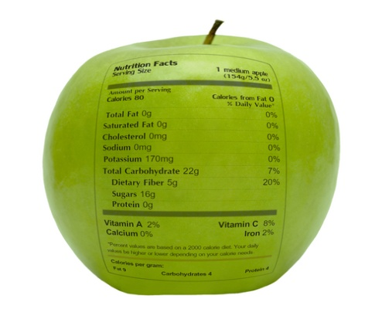
شكراً لاستماعكم
سبحنك اللهم وبحمدك أشهد أن لا إله إلا أنت، أستغفرك وأتوب إليك
د. هاني منصور المزيدي
مع الأخ أمجد محبوب في أستراليا سنة 1981
Dr. Hani Mansour Al-Mazeedi
With brother Amjad Mahboob in Australia in 1981

Slide 36
www.HalalEA.com
Trademarks, icons, images belong to their respective owners.
© Halal Sciences Academy Limited

